Slide 1


Slide 2
INTRODUCTION TO TOOTH MORPHOLOGY
Dr Asma Saher Ansari
Assistant Professor Oral Biology
DIKIOHS

Slide 3
Pre-Test
Which of the following is NOT a primary function of dental anatomy?
a) Understanding tooth morphology b) Studying tooth eruption patterns c) Diagnosing systemic diseases d) Learning occlusion patterns
Answer: c) Diagnosing systemic diseases

Slide 4
How many sets of dentition do humans naturally develop in their lifetime?
a) One b) Two c) Three d) Four
Answer: b) Two

Slide 5
Have you heard about FDI or ADA
The American Dental Association (ADA) and the Fédération Dentaire Internationale (FDI) are two major dental organizations, but they have different scopes, functions.
ADA (American Dental Association) | FDI (Fédération Dentaire Internationale)
1859 (USA) | 1900 (Switzerland, International)
National (United States) | International (Global)
Standardization, education, advocacy, and policy-making for dentists in the U.S. | Global oral health promotion, research, and standardization in dentistry.

Slide 6
Which part of the tooth is covered by enamel?
a) Root b) Crown c) Pulp d) Cementum
Answer b) Crown

Slide 7
Introduction to human dentition

Slide 8
Learning Objectives:
By the end of this lecture, students should be able to:
Define dental anatomy and its significance in clinical practice.
Describe the formation and classification of dentitions.
Understand dental nomenclature and various tooth numbering systems.
Identify the divisions of teeth into thirds, line angles, and point angles.

Slide 9
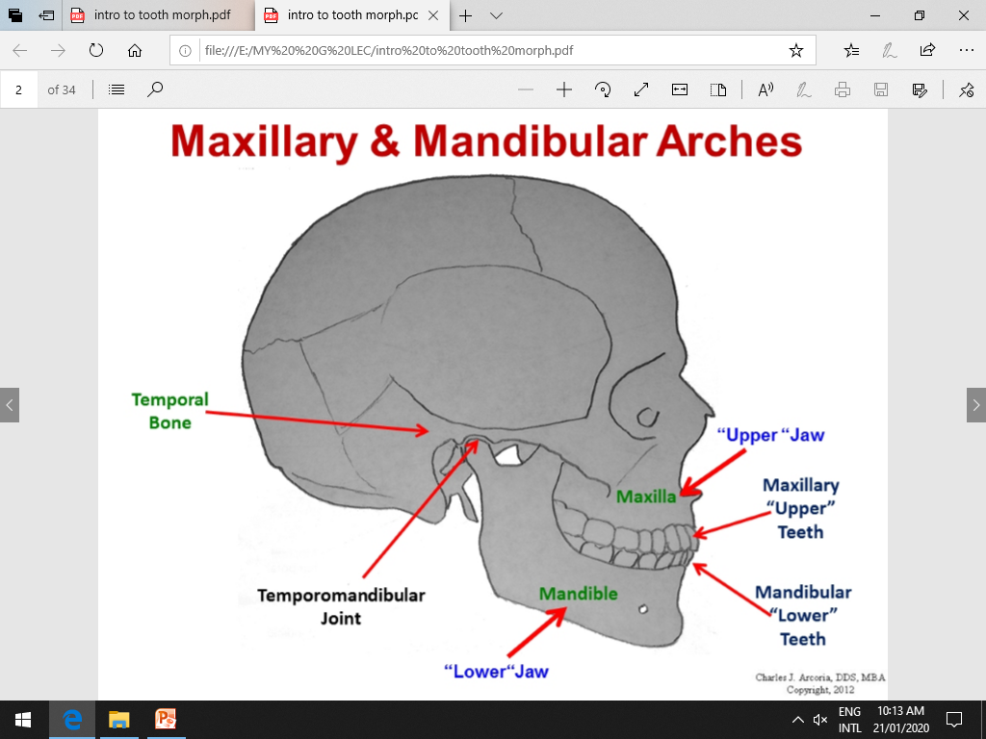

Slide 10
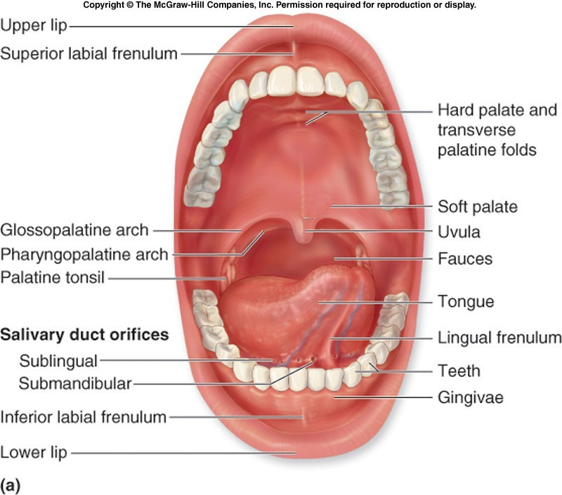
1. Introduction to oral structures:
Each human being has 2 jaws:
Upper jaw maxilla maxillary teeth. Lower jaw mandible mandibular teeth. A midline divides the oral cavity into 2 equal halves. So the teeth in oral cavity are divided into
4 Quadrants

Slide 11
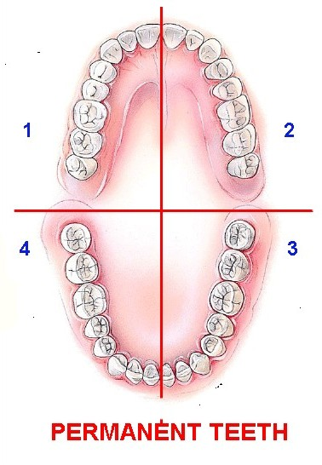


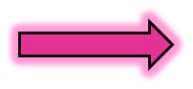

Maxillary Left quadrant
Maxillary Right quadrant
Mandibular Right quadrant
Mandibular Left quadrant

Slide 12
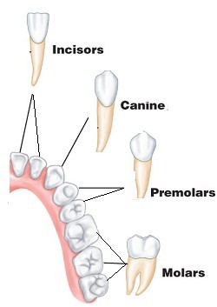
Types of teeth. 2
There are 4 types of teeth:
Two types called Anteriors
The other 2 types are called Posteriors

Slide 13
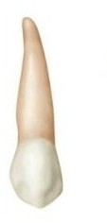
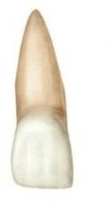
Anterior teeth
Canines There is 1 canine in each quadrant
Has 1 cusp so called (cuspid)
Incisors
There are 2 incisors in each quadrant
1 central next to midline 1 lateral

Slide 14
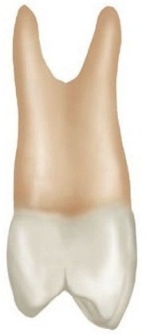
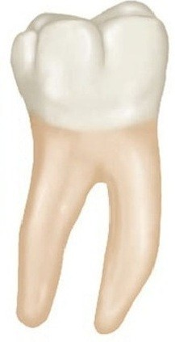
Posterior teeth
premolars
There are 2 in each quadrant 1st & 2nd premolars
Mainly have 2 cusps
Molars There are 3 in each quadrant 1st, 2nd, 3rd
The are multicuspid and multirooted

Slide 15
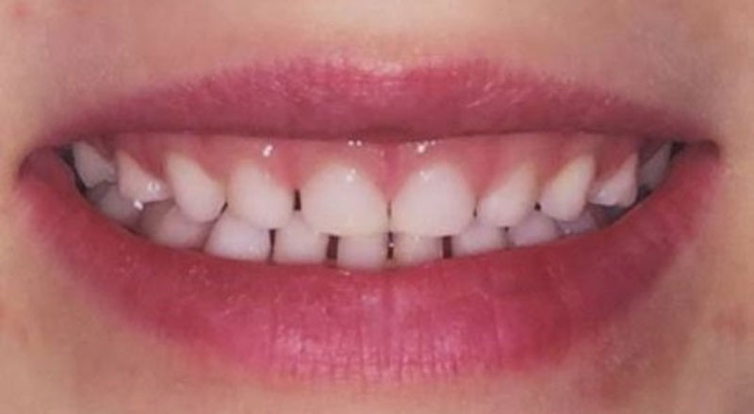
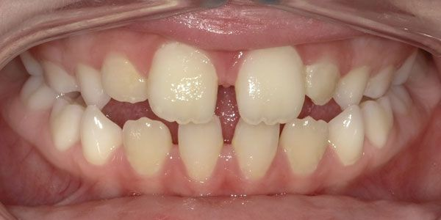
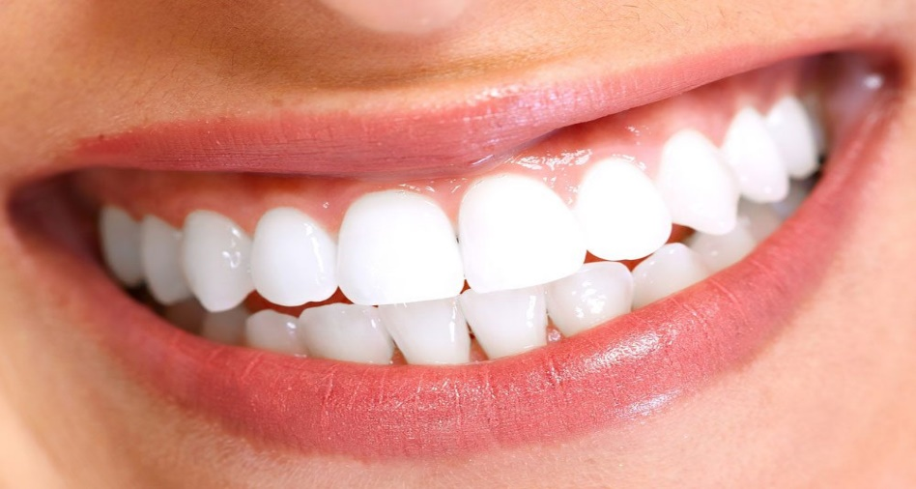
:Types of dentition. 3
There are 3 types of dentition in humans:
DECIDUOUS DENTITION
MIXED DENTITION
PERMANENT DENTITION

Slide 16
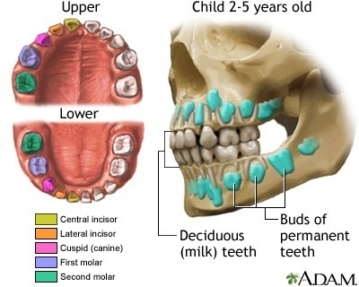
1. Deciduous dentition:
They are also called primary, milk, or temporary teeth.
The teeth start to appear at 6 months and continue to erupt till age of 2.5-3 years.
They are 20 in number. 5 for each quadrant.
2 Incisors.
1Canine.
2 Deciduous Molars.
These teeth are called (Predecessors)

Slide 17
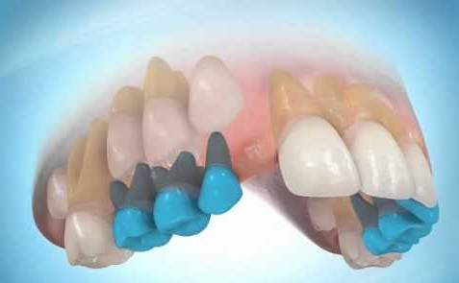
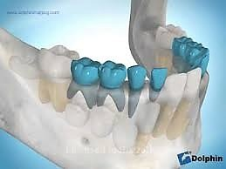
2. Mixed dentition:
It is type of dentition where both deciduous and permanent teeth are present in the oral cavity.
It usually starts with eruption of 1st permanent molar.
Begins from 6-12 years with the shedding of last deciduous tooth

Slide 18
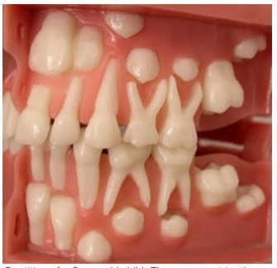
Succedaneous teeth:
20 decideous teeth permanent teeth.
are replaced by 20
M
2 D Incisors are replaced by 2 P Incisors
1 D Canine is replaced by 1 P Canine
2 D Molars are replaced by 2 Premolars
The 3 Permanent Molars are not considered as a succedaneous teeth (no predecessors)
M

Slide 19
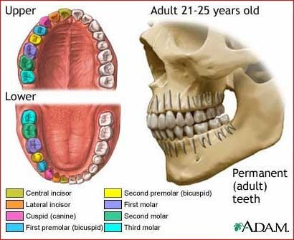
3. Permanent dentition:
They are also called secondary or adult teeth
They start to erupt at 6 years till nearly 21 years with eruption of permanent 3rd molar (wisdom tooth).
They last for long time and are not replaced.
They are 32 teeth
In each quadrant:
2 incisors central and lateral (1,2)
1 canine (3) 2 premolars (4, 5) 3 molars (6,7,8)

Slide 20
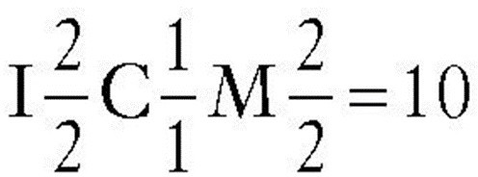
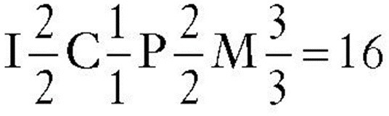
Dental formula.
A number and letter designation of the various types of teeth found in a dentition.
It indicates the dentition of only one side of the mouth, but includes upper and lower teeth, so dental formula includes just half of the teeth
Deciduous
Permanent

Slide 21
Numbering systems.
It is used to serve as abbreviations instead of writing the entire name of a tooth
These symbols will let us know the tooth is either
Deciduous or permanent
Upper or lower
Right or left
The tooth type
There are 3 numbering or notation systems: A.Palmer numbering system.
B.International (two digit) system. C.Universal numbering system.

Slide 22
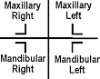
:A. Palmer numbering system
(Symbolic system using quadrant brackets and numbers).
In this system we start from midline.
So number 1 will be for central incisor. while 8 will be for 3rd molar.

Slide 23
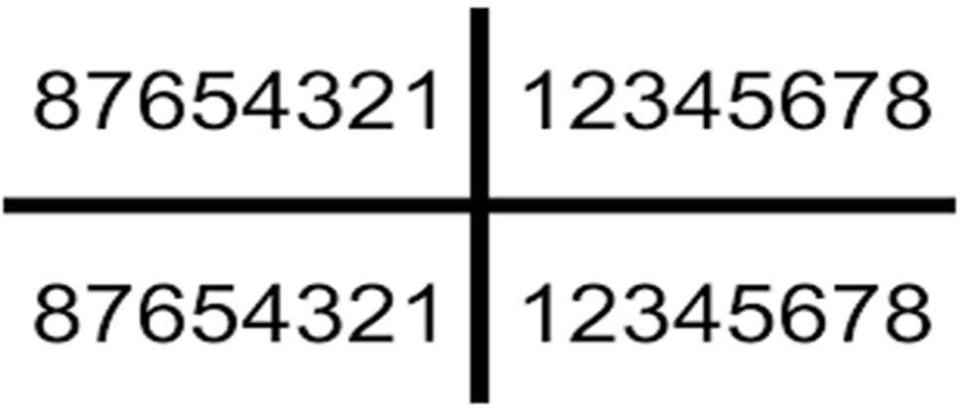
A. Palmer numbering system
permanent teeth:
3
Ex: This symbol denotes upper right canine.
5
What’s ?

Slide 24
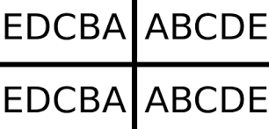
Deciduous teeth:
It starts also from midline. But for deciduous teeth we give alphabetic letters.
From deciduous central incisor
A. ending with deciduous second molar E.
Each quadrant has only 5 teeth.

Slide 25
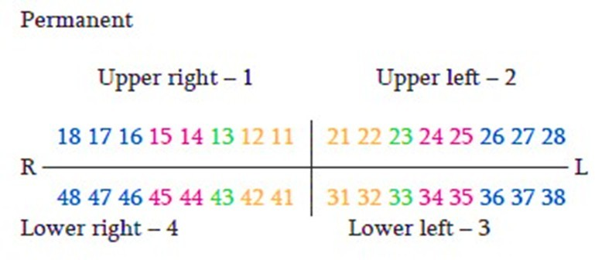
B. FDI Two-Digit system (international):
Used internationally, numbers quadrants 1-4 for permanent and 5-8 for primary dentition)​
The one on the left is number of quadrant
The other on the right is for the tooth type

Slide 26

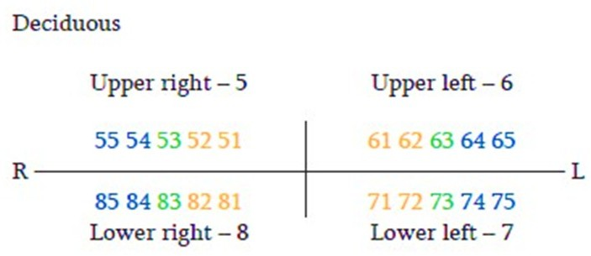
For deciduous
Upper right quadrant takes no. 5 Upper left no. 6
Lower left no. 7
Lower right no. 8 in a clockwise direction
66
84

Slide 27
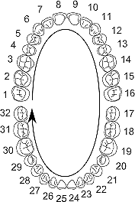
C. Universal system
(ADA-recommended, and A-T for primary teeth).
Permanent :uses numbers 1-32 for permanent teeth
Starting from upper right 3rd molar(1) proceeding clockwise, and ending by lower right third molar (32).
It is always preceded by # sign

Slide 28

Deciduous:
^{Uses Alphabet} A-T for primary teeth
#O is lower left deciduous central incisor

Slide 29
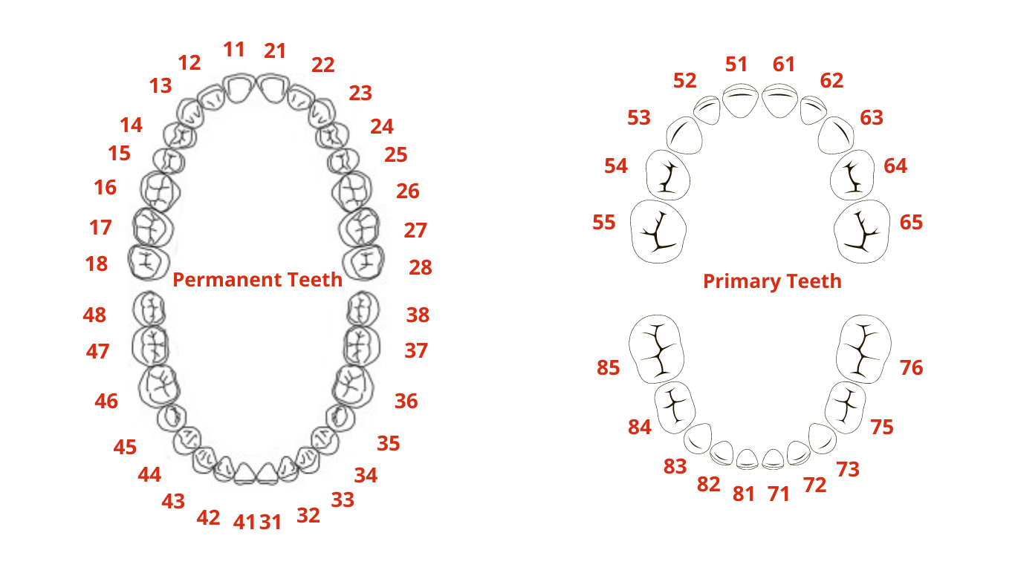

Slide 30
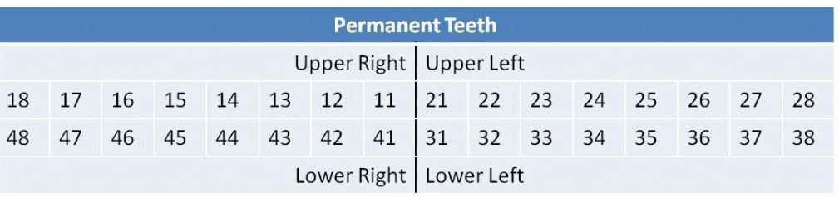
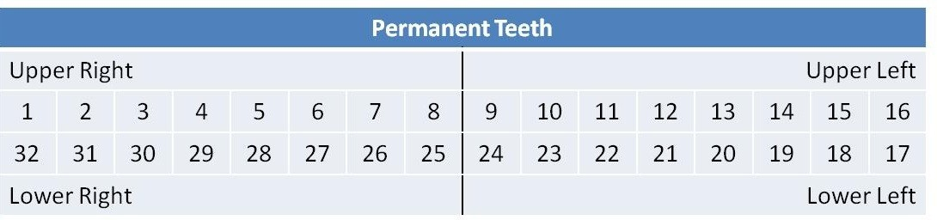

Slide 31
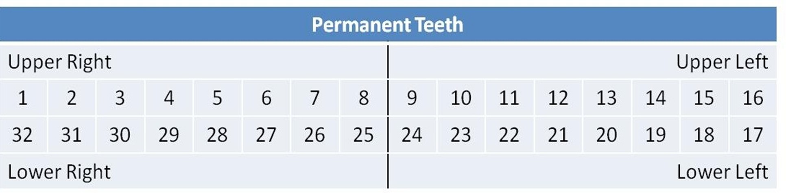
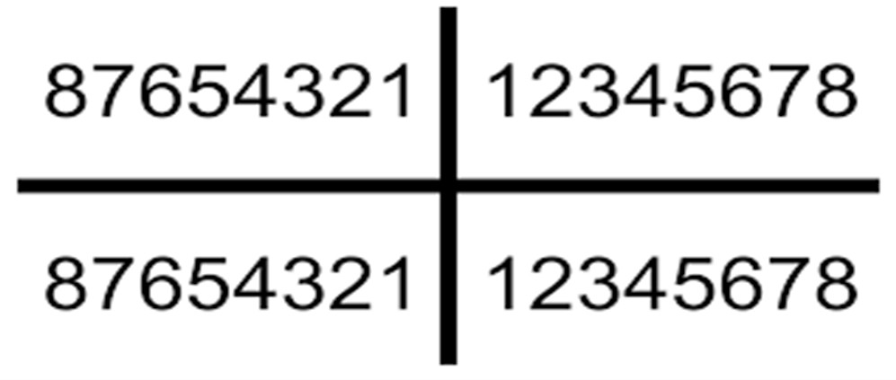
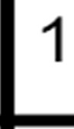

Slide 32
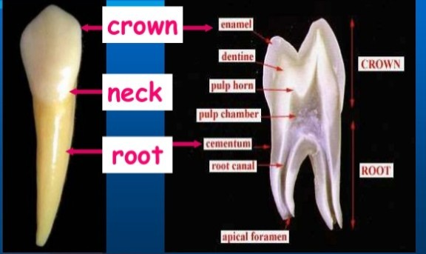
:Macro &micro anatomy. 6

Slide 33
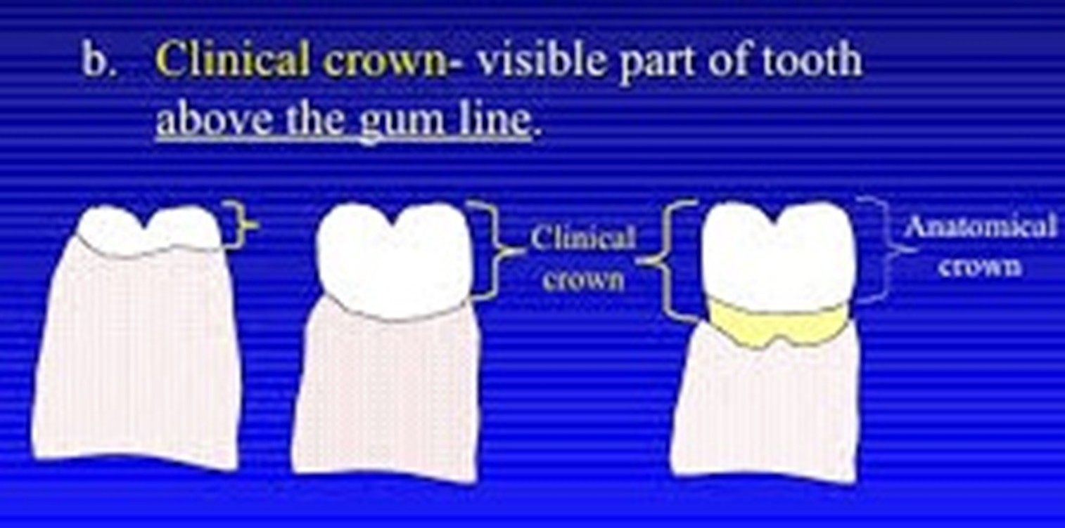
Anatomical Crown is that part of the tooth that is covered by Enamel or outer covering of the tooth. Its up to the cement-enamel junction.
Clinical crown is that part that is visible in the oral cavity.

Slide 34
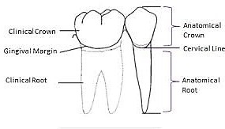
Anatomical root portion of root covered by cementum, defined by CEJ.
Clinical root: portion of root that is not visible in mouth.

Slide 35
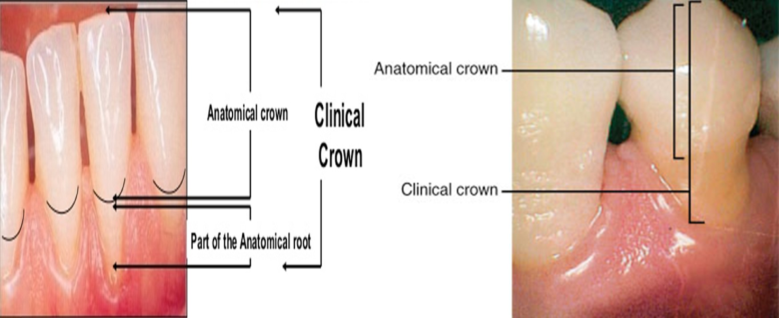

Slide 36
Surfaces of teeth. 7
Crowns of anterior teeth have 4 surfaces and edge. While those of posterior surfaces have 5 surfaces.
1.Facial 2.Lingual 3.Mesial 4.Distal
5.Incisal or occlusal

Slide 37
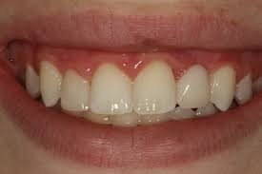
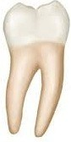
1. Facial surface
labial surface
The outside surface of anterior teeth facing lip
Buccal surface
The outside surface of
posterior cheeks muscle)
teeth facing
(buccinator

Slide 38
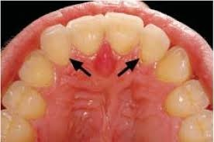
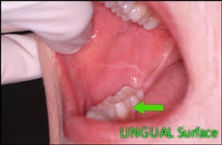
2. lingual/ palatal surface:
The inner surface of teeth facing tongue or palate.

Slide 39
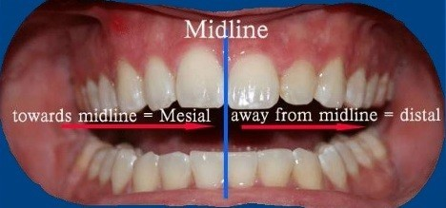
3. Mesial surface:
toward Midline
4. Distal surface:
Distant from midline

Slide 40
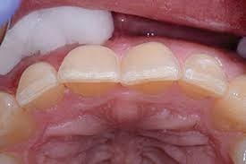
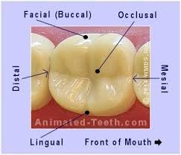
Incisal surface
Biting surface of anterior teeth
Occlusal surface Chewing surface of posterior teeth

Slide 41
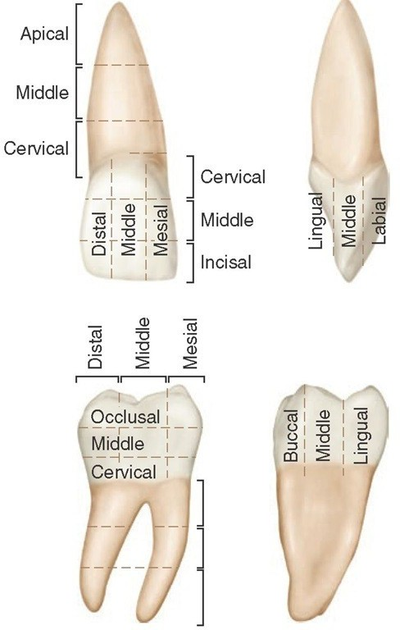

Slide 42


Line and point angles. 8
Line angle: is the junction between 2 adjacent surfaces and it is named according to the 2 surfaces sharing in its formation.
Point angle: is the junction between 3 adjacent surfaces and it is named according to the 3 surfaces sharing in its formation meeting in a point

Slide 43
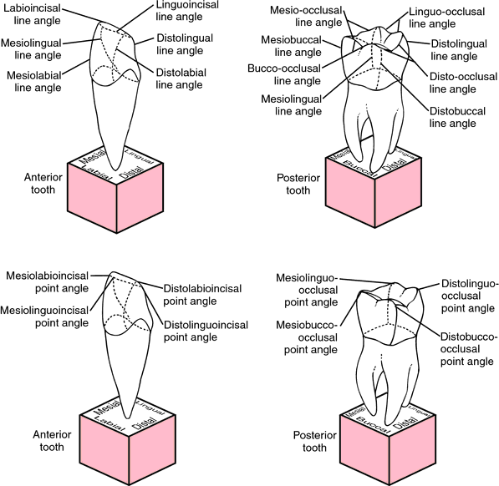

6
8
4

Slide 44
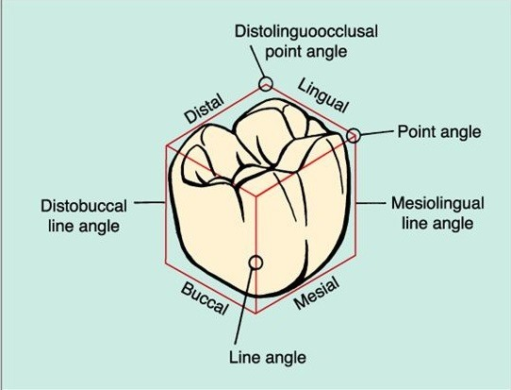

Slide 45
Post Test
1) Which of the following describes the transition from primary to permanent dentition?
a) Mixed dentition b) Partial dentition c) Deciduous dentition d) Succedaneous dentition

Slide 46
2) In the FDI system, what number represents the upper left first molar?
a) 16 b) 26 c) 36 d) 46

Slide 47
3) Which of the following tooth surfaces faces the lips or cheeks?
a) Lingual b) Occlusal c) Facial d) Incisal

Slide 48
4) A tooth is divided into three sections vertically and horizontally. What is the middle third of the crown called?
a) Cervical third b) Incisal/Occlusal third c) Middle third d) Apical third

Slide 49
5) Which of the following is TRUE about line and point angles?
a) A line angle is formed by the junction of three surfaces b) A point angle is formed by the junction of two surfaces c) A point angle is formed by the junction of three surfaces d) Line and point angles are only found on posterior teeth

